Slide 1
Physical Database Design
Adapted from Chapter 18 (Connolly & Begg)

Slide 2
Physical database design
Goal: create a relational database schema from the relational model that can be implemented in the target DBMS.
Physical database design: defining the description of the database on secondary storage.
It describes the base relations, the file organization, the indexes, the integrity constraints, and security measures.

Slide 3
Steps to the physical database design
Define base relations for the chosen DBMS
Design representation of derived data
Design general constraints for the table
Not supported in MySQL
Design file organizations and indexes
MySQL uses the InnoDB structure a version of B trees
Indexes: storage mechanism used to speed up data retrieval
We will study indexes and B trees later in the semester
Estimate disk space requirements
Design user views
Design security mechanism

Slide 4
Design base relations
Specify unique name for each relation
Specify list of simple attributes and domains, default values, NULLs permitted
Specify primary key and foreign keys
Specify referential integrity constraints

Slide 5
Design representation of derived data
Ensure data needed to derive field is present
If data is difficult to derive, some designers may choose to store the derived field as a simple field and define rules for it to be updated

Slide 6
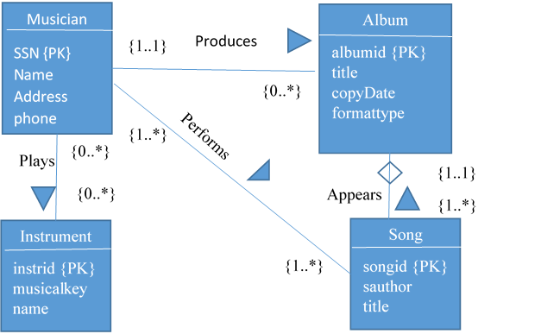
Classwork: design relations for model

